Slide 1


Case Study: Chronic Kidney Disease

Slide 2
Chronic Kidney Disease
Chronic kidney disease is a leading public health problem worldwide. The global estimated prevalence of CKD is nearly 13%.
Nearly 700 million people worldwide live with CKD conditions.
It is a silent disease in its early stages, leading to low detection rates.
approximately 20-30% of patients admitted with COVID-19 developed kidney failure. Most prevalent risk factor for covid related complications.
* source of Information: International Federation of Kidney Foundations , American Kidney Fund.

Slide 3
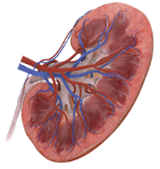
Chronic Kidney Disease
Chronic kidney disease (CKD) is divided into five stages. The stages are based on the eGFR test indicating how well your kidneys function.
eGFR can be calculated using creatinine amounts in blood and other demographics information of patients.
The recommended method for estimating GFR in adults is the 2021 CKD-EPI equations ( National Kidney Foundation )
eGFR
>= 90
60 - 89
45 - 59
30-44
15-29
<15
Stage
Stage3a
Stage 3b
Stage 4
Stage 5
Stage 1
Stage 2
Mild Damage
Mild Damage
Moderate Damage
Moderate Damage
Severe Damage
Approaching Kidney Failure
* source of Information: International Federation of Kidney Foundations , American Kidney Fund.

Slide 4



The Data Challenge
A cohort of 300 patients who are at different stages of the disease. Many are on medications. Historical Lab test results are available. We also know how many experienced a progression in the disease stage.
Demographics
Prediction of Disease Progression
Lab Tests
Medication History

Slide 5
The Data Challenge
A cohort of 300 patients who are at different stages of the disease. Many are on medications. Historical Lab test results are available. We also know how many experienced a progression in the disease stage.
Objectives:
Identify the attributes of a patient that strongly influence the progression.
Identify the drug efficacies where possible.
Build a predictive model which can predict the patient outcome based on these strong attributes.
Improve on the accuracy of the model.

Slide 6
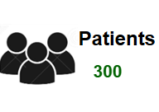

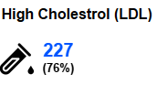
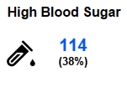


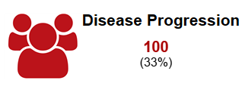
Summary Statistics
166 patients record more than 1.3 mg/dl creatinine levels in serum. 100 patients have been diagnosed with advanced stages of CKD
Standard universal thresholds are used to consider a case as high or normal levels in blood samples.

Slide 7
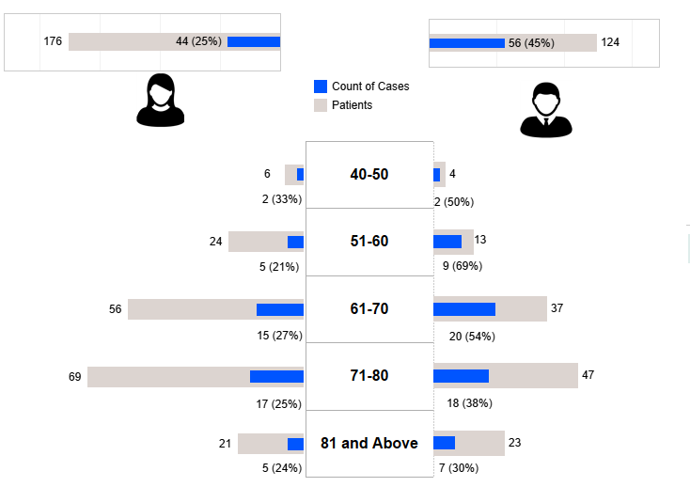
Demographics
Most of the population fall under the age bracket of 61 –80 . Thus, observed cases are more along those groups.
Cases in males and females about 2:1

Slide 8
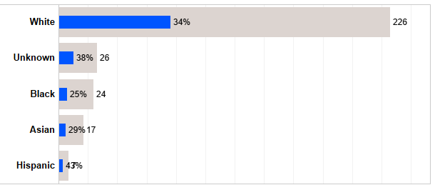
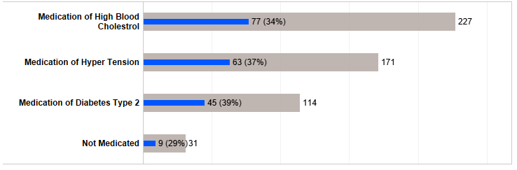
Demographics & Medications
Insufficient observations across all races of patients.
Most patients are on medication with nearly 60% on multiple drugs for comorbidities.

Slide 9
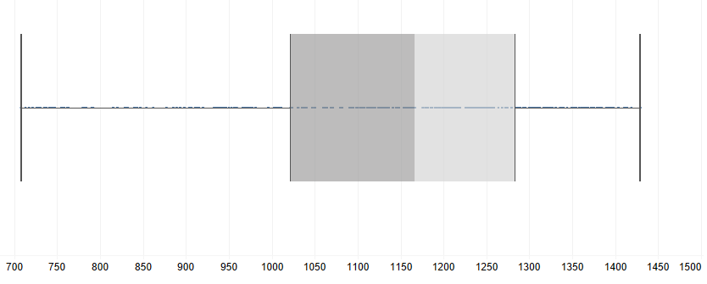
Data Anomalies
Longitudinal data is not uniform for every member. Standardization must be considered and imputation of not available data points
700 days
1500 days
Observation Period
Insufficient subjects for all but one races . Thus, would introduce bias on results if introduced as model inputs.
Only 100 out of the 300 subjects are identified as cases of disease progress. Predictive models must account for 'class imbalance'

Slide 10
Data Anomalies
Method followed to label a patient as a case of progression is not clear.
ID | Creatinine | eGFR | CKD | target
220 | 0.77 | 93 | 1 | 0
220 | 0.77 | 93 | 1 | 0
220 | 1.01 | 76 | 2 | 0
220 | 1.01 | 76 | 2 | 0
220 | 1.01 | 76 | 2 | 0
220 | 0.92 | 85 | 2 | 0
220 | 0.92 | 85 | 2 | 0
220 | 0.82 | 91 | 1 | 0
220 | 0.82 | 91 | 1 | 0
220 | 1.09 | 69 | 2 | 0
220 | 1.09 | 69 | 2 | 0
220 | 1.09 | 69 | 2 | 0
Applying this logic of progression it appears that 128 members had a progression during the observation period. Only 45 members seem to have the same value for the original target variable and the new one.
However, since the number 128 is not significantly high , the original target value is considered.

Slide 11
Methodology
The longitudinal data is aggregated at patient level. Simple logistic regression and random forest classifier are tested on the aggregated data.
The aggregation can be of many types : max , min, average or recent most. With elimination method the best operation is decided.
Pre-existing conditions (such as whether patient is already in Stage1) are also considered as derived features.
Feature scaling and class imbalance penalties are applied as applicable.

Slide 12
Weight of Evidence Technique
Weight of evidence techniques prove very efficient for logistic regressions.
Help identify the strong predictors to use in a model (Information Value)
Help interpret the model results better by inspecting the effect of each category
Test Result | Range |  | WOE | IV
Glucose Level | 3.5 | 5.6 | -0.40547 | 0.169468
Glucose Level | 5.7 | 6.3 | -0.19416 | 0.169468
Glucose Level | 6.4 | 7.4 | -0.1226 | 0.169468
Glucose Level | 7.5 | 16.4 | 0.665748 | 0.169468

Slide 13
Top Influencers
Pre-existing Kidney Condition
Blood Glucose Levels
low-density lipoprotein (LDL-c) level
Systolic Blood Pressure
Blood Hemoglobin Levels

Slide 14
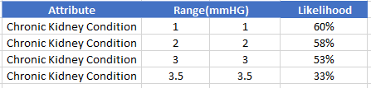
Top Influencers
Pre-existing Kidney Condition
Blood Glucose Levels
low-density lipoprotein (LDL-c) level
Systolic Blood Pressure
Blood Hemoglobin Levels

Slide 15
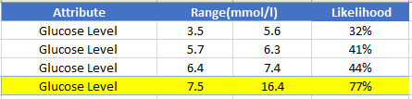
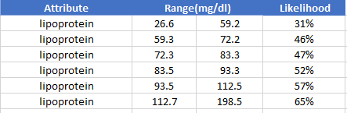
Top Influencers
Pre-existing Kidney Condition
Blood Glucose Levels
low-density lipoprotein (LDL-c) level
Systolic Blood Pressure
Blood Hemoglobin Levels

Slide 16
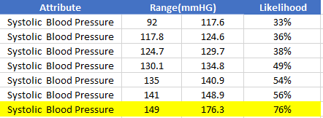
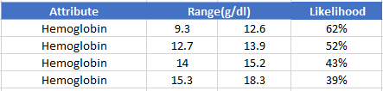
Top Influencers
Pre-existing Kidney Condition
Blood Glucose Levels
low-density lipoprotein (LDL-c) level
Systolic Blood Pressure
Blood Hemoglobin Levels

Slide 17
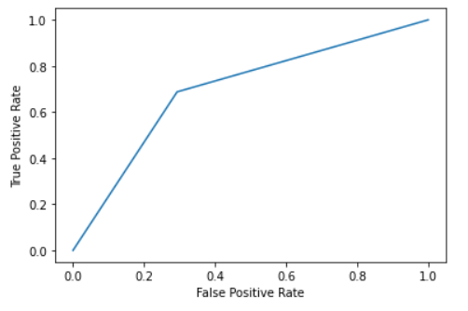
Accuracy of Predictions
Class imbalance imply looking at precision and recall metrices
Precision
Recall
F1 Score
56%
70%
62%

Slide 18
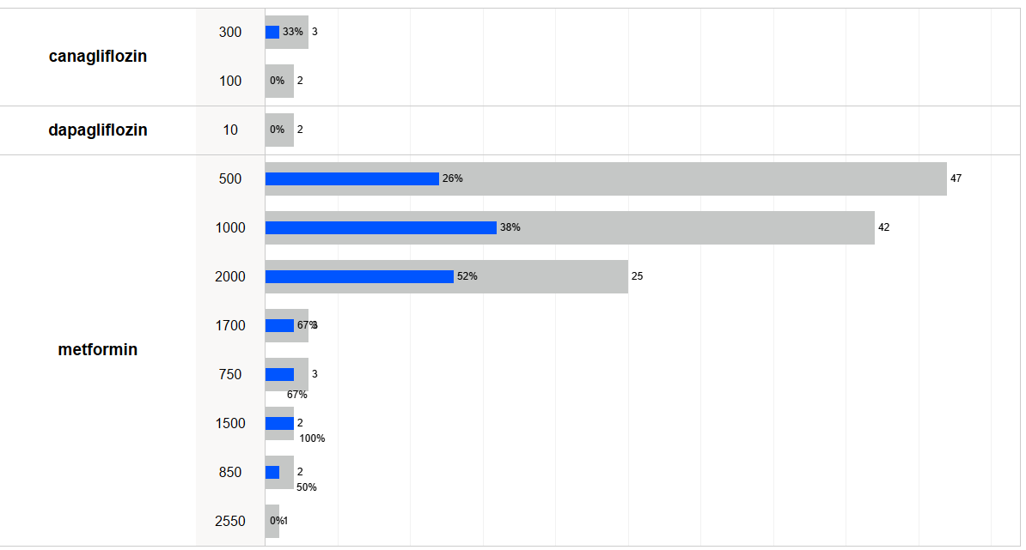
Drug Efficacies (Blood Sugar)
How are the medications performing in terms of keeping the lab test results under control ?
Metformin is the prevalent medication to treat blood sugar levels on the subjects.
Higher doses do not imply better outcomes based on the observations.

Slide 19
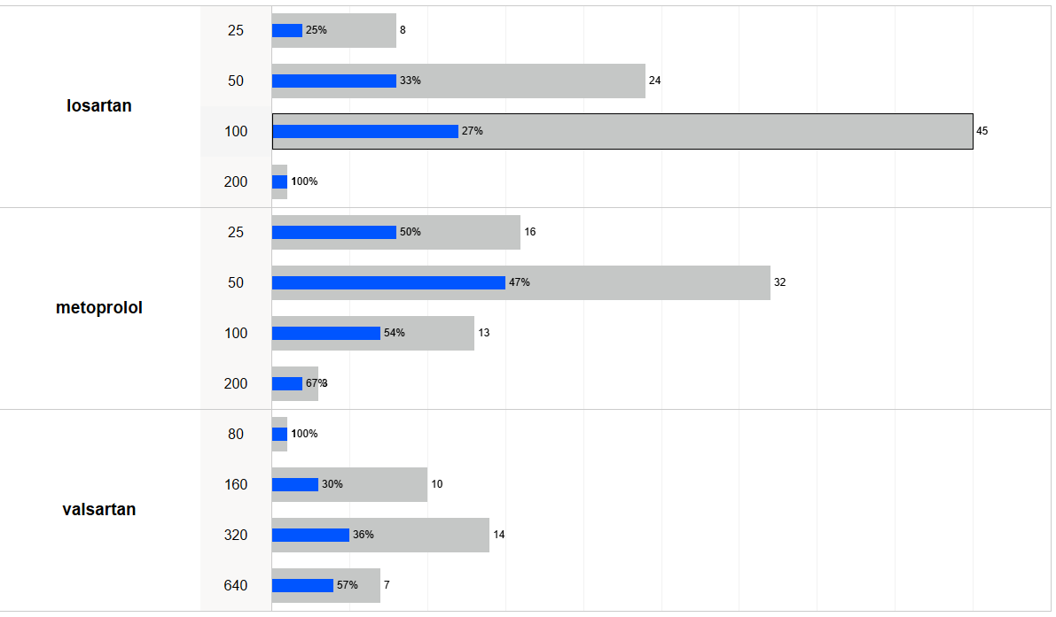
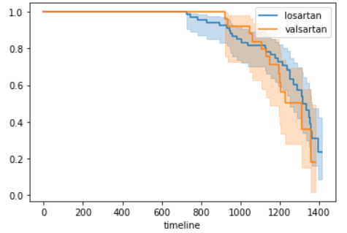
Drug Efficacies (Hyper Tension)
Three primary medications to treat hyper tension wherein losartan and valsartan are of the same drug class.
If the incidence of a progression is considered an event , a survival analysis plot for the two drugs can be observed for any patterns.

Slide 20
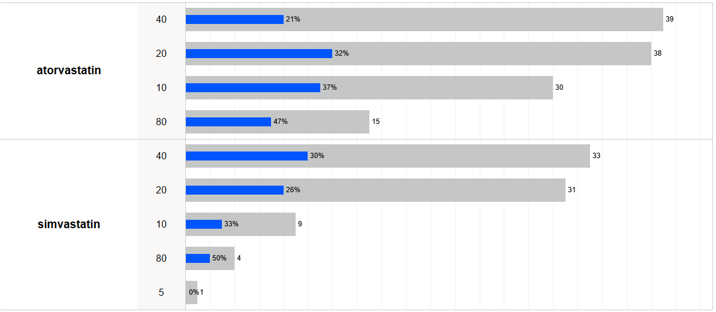
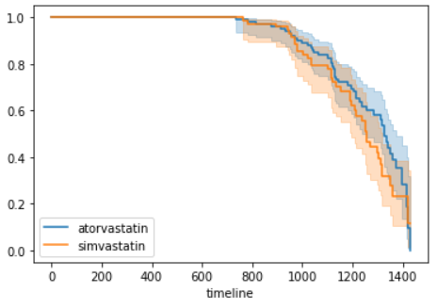
Drug Efficacies (Cholesterol)
Two primary statin medications are observed on patients with high cholesterol.

Slide 21
Deep learning on temporal data
Temporal information of data is not preserved while feeding to the simple models.
The longitudinal data can be used to experiment on an advanced model such as a Recurrent Neural Network or a Convolutional Neural Network.
While the size of the data is not ideal to fuel such models , we can observe whether the accuracy of the model appears superior
To introduce a standard observation window , last 15 observations of every patient is considered. Forward fill imputation applied.

Slide 22
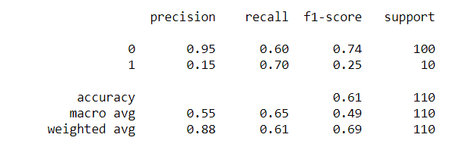
Deep learning on temporal data
The publication titled ' Learning from Longitudinal Electronic Health Record ' has been referenced for designing and tuning the models. The paper has been published by : Zhao J, Feng Q, Wu P, Lupu R, Wilke RA, Wells QS, Denny JC, Wei W-Q
A LSTM model under RNN is explored using the longitudinal and static information.

Slide 23
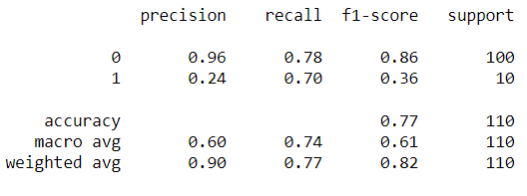
Deep learning on temporal data
The publication titled ' Learning from Longitudinal Electronic Health Record ' has been referenced for designing and tuning the models. The paper has been published by : Zhao J, Feng Q, Wu P, Lupu R, Wilke RA, Wells QS, Denny JC, Wei W-Q
A Convolutional network is explored using the longitudinal and static information.

Slide 24

Conclusion
Identify the attributes of a patient that strongly influence the progression.
Identify the drug efficacies where possible.
Build a predictive model which can predict the patient outcome based on these strong attributes.
Improve on the accuracy of the model.
Initial Objectives

Slide 25

Conclusion
The strong predictors have been conclusively identified. A distinct threshold value for blood sugar and blood pressure levels could be identified beyond which the risks significantly surge.
Demographics such as gender did not have a strong influence. This is surprising since historically males are more prone to CKD. The sample size of the data may be the underlying reason.
The predictive models demonstrate good recall value. However, the precision of the models are still low.
The CNN secures a marginal improvement over the simple models. There lies room for improvement. Customized loss functions may be more efficient since oversampling seldom add new information.

Slide 26


